Slide 1

Heliopolis University for Sustainable Development
Organic livestock Husbandry
(5150)
2nd semester
2021/2022

Slide 2
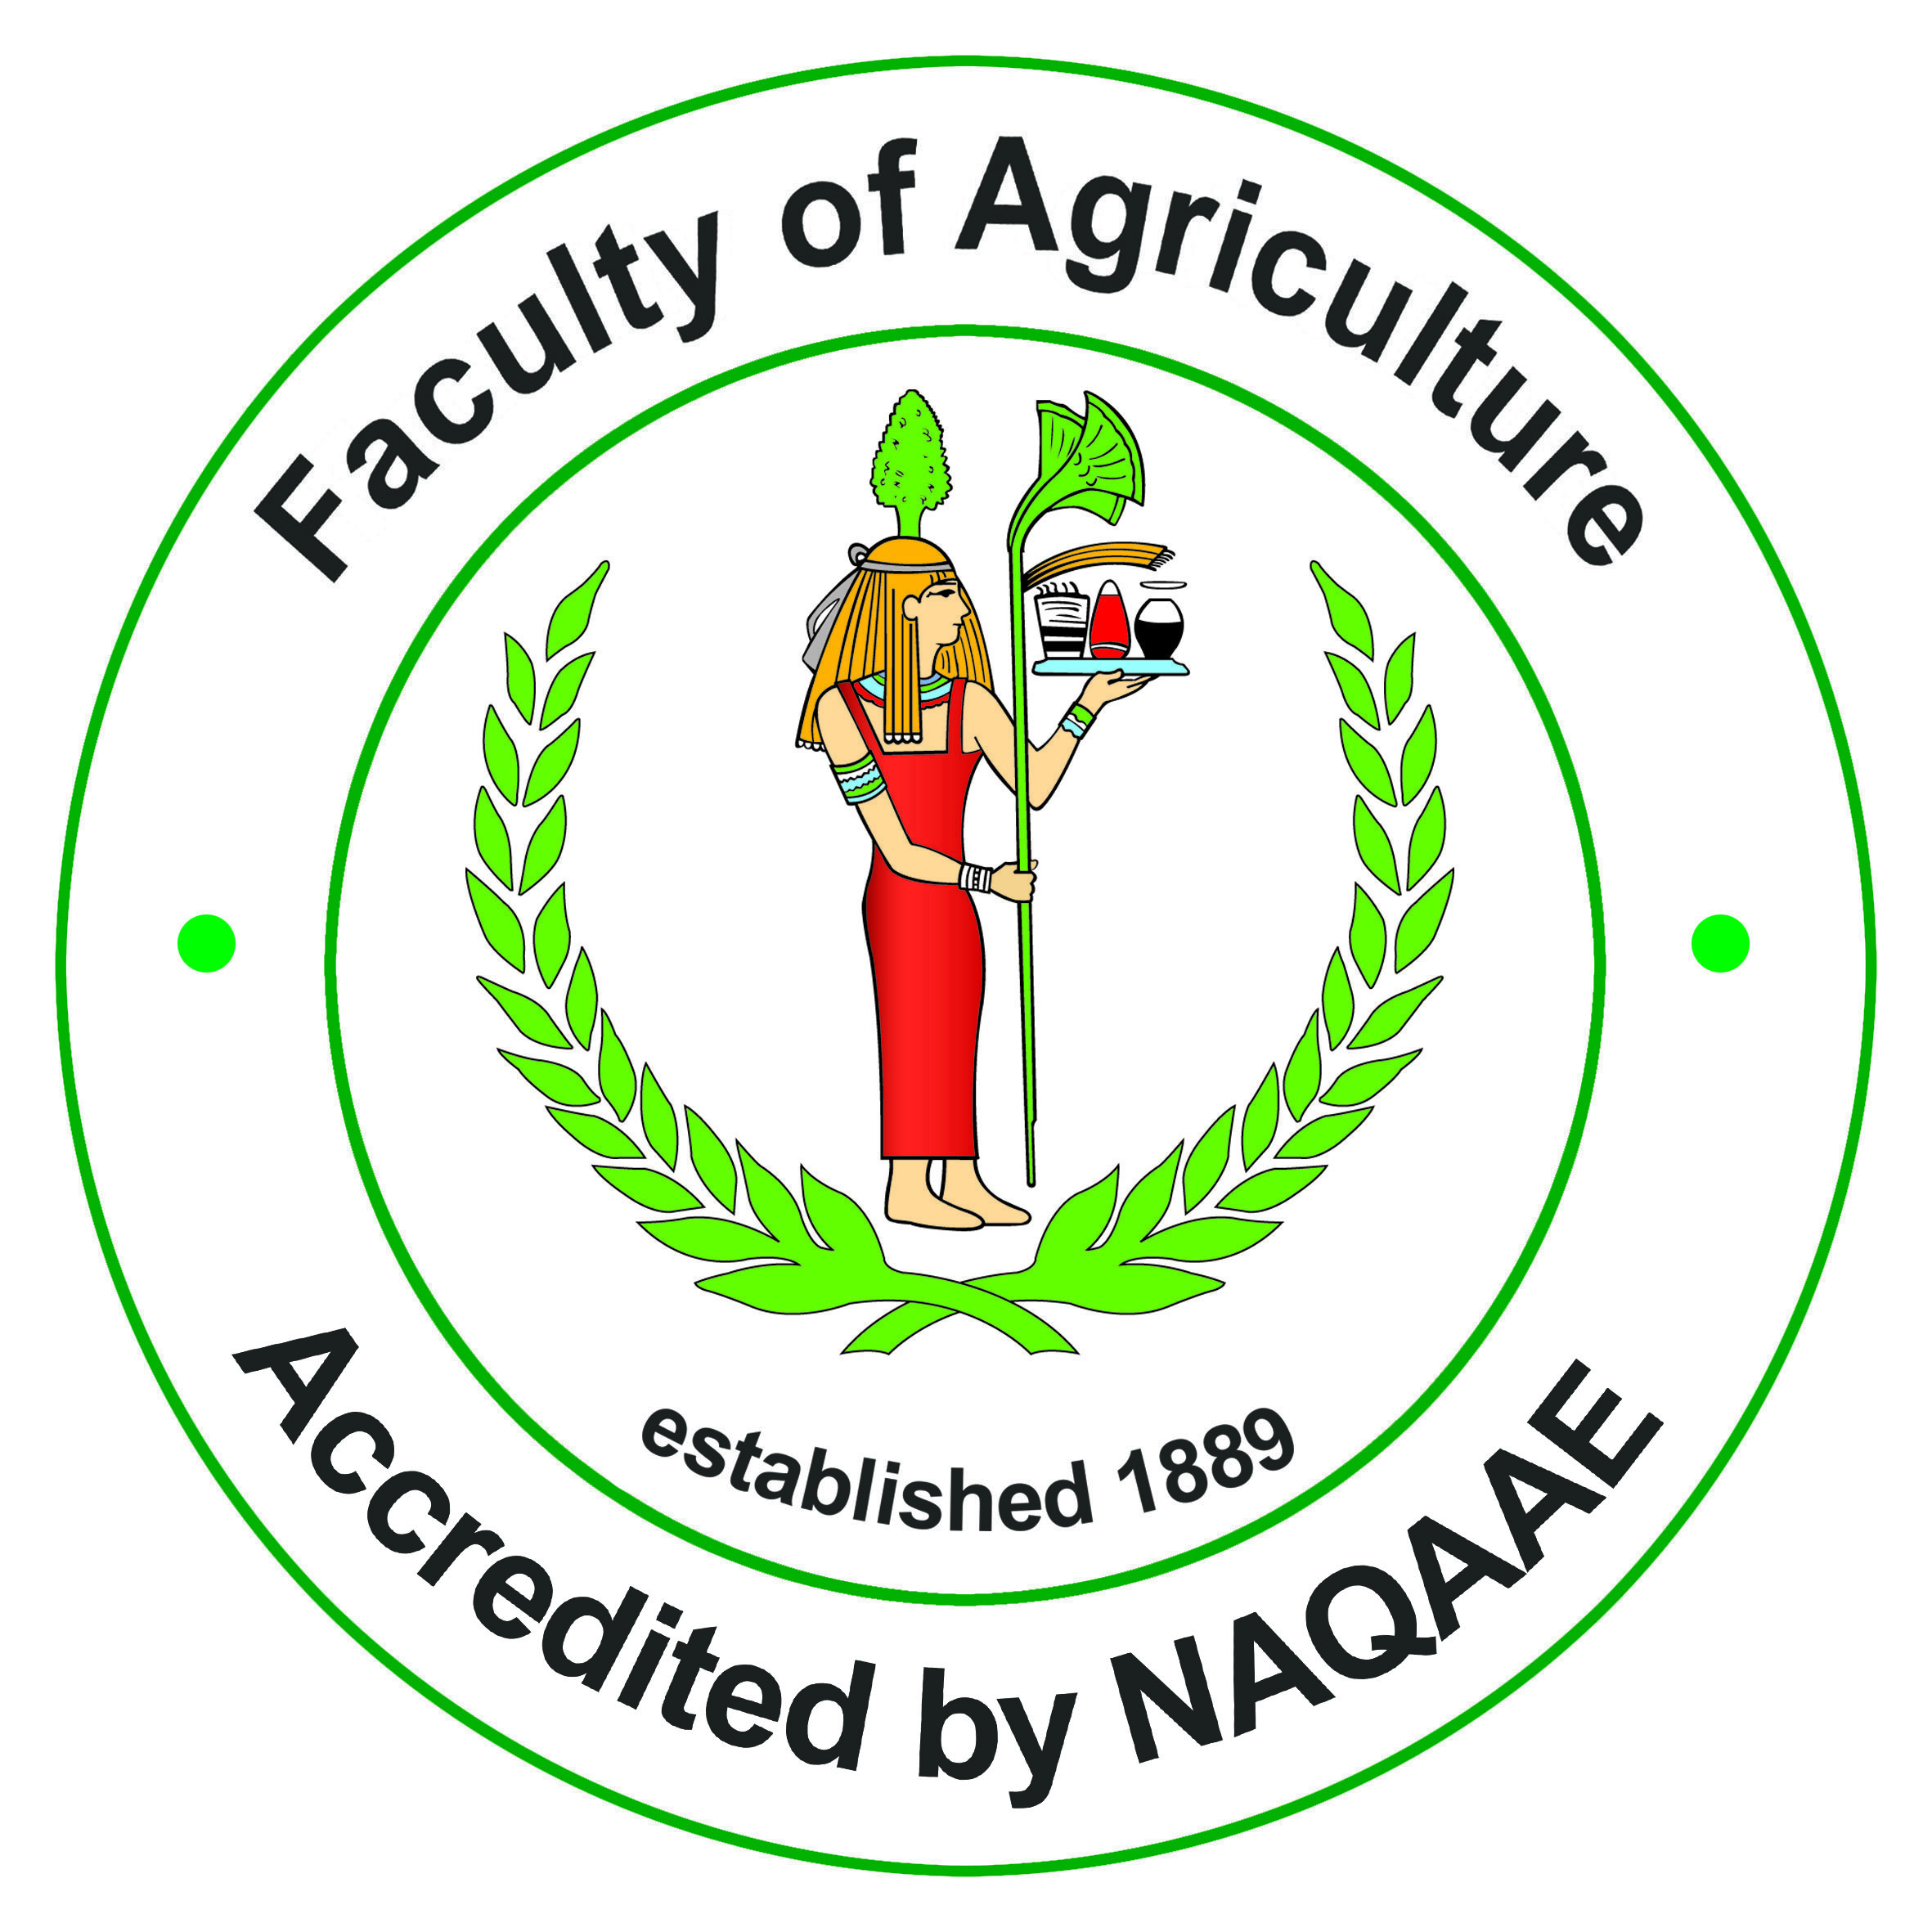

By
Dr. Hassan Awny Fouad Rahmy
lecturer
Fac. of Agric. Cairo Univ., Animal prod. Dep. “Nutrition branch”
2022

Slide 3
Organic livestock products

Slide 4
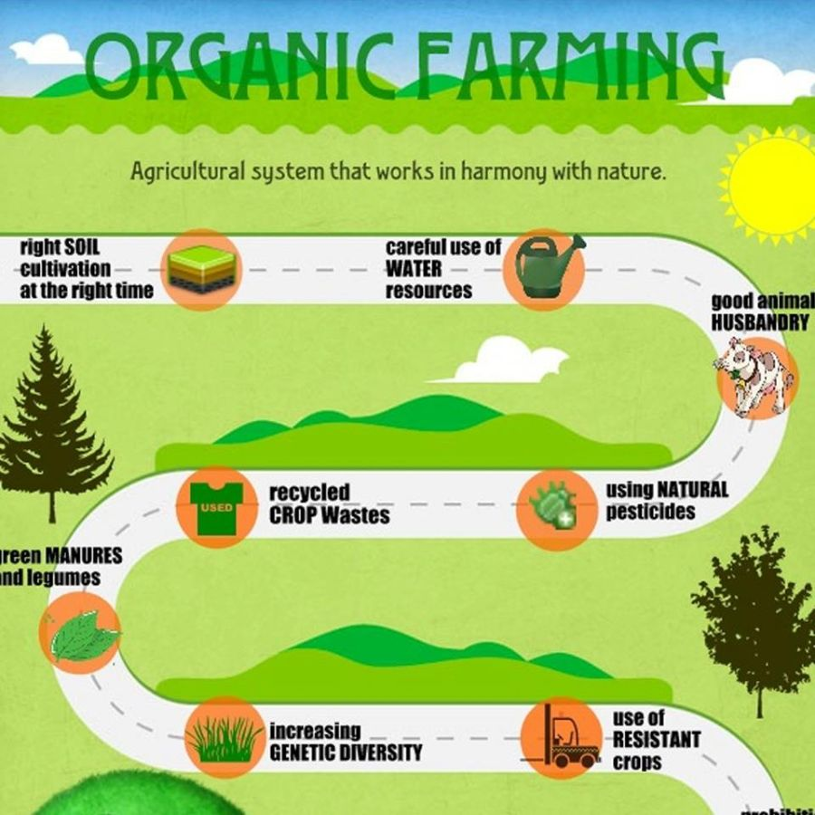

Slide 5
introduction
Organic farming is based on a set of principles that are related to preserving nature, protecting the environment, ensuring sustainability of food production and welfare of the animals.
These principles are implemented in practice by enforcing sets of standards and regulations.
Many countries in Europe and N. America have implemented sets of regulations and standards for animal housing conditions, veterinary supervision, and strict principals for animal husbandry and nutrition that ensure meeting their nutritional requirements from organically certified feedstuffs.

Slide 6
introduction
In organic farming animal husbandry is often understood in terms of natural living.
One of the main and basic principles of organic farming is that animals are kept as a part of the whole production system and their nutrition should be based on locally grown organic feedstuffs.
Aiming for a high level of self sufficiency, the feed should preferably be obtained from the same holding where the animals are kept.

Slide 7
Feeding in organic livestock production
As a general rule, all natural (non-synthetic) feed substances are allowed in organic production and all synthetic chemical substances are prohibited.
Feeding synthetic feed additives is forbidden not only because they are not natural but also because the production of these feed additives usually involves use of chemicals and sources of energy that are not friendly to the environment
The approach of natural living in organic farming is not just of avoiding chemicals, it is also about respecting ecological principles and the integrity of nature as a whole.

Slide 8
Feeding in organic livestock production
Feed in organic nutrition is intended to ensure high quality of the end products rather than maximising production, while meeting the nutritional requirements of the livestock at various stages of their development.
The probability of developing problems with animal health and welfare increase with higher level of production using artificial means.
Animal breeds with high productivity levels may have high nutrient requirements that are difficult to meet by using 100% locally grown organic feed. Approved nutritional supplement may be used under certain strict conditions.

Slide 9
Feeding in organic livestock production
EU Regulation requires that 60% of the feed for aniamals (20% for pigs and poultry) should come from the farm itself or be produced in cooperation with other (local) organic farms.
Rearing systems for herbivores are to be based on maximum use of pasturage according to the availability of pastures at different seasons of the year.
For herbivores, at least 60% (50% during the first 3 months of lactation) of the dry matter of daily rations is to consist of roughage, fresh or dried fodder, or silage.

Slide 10
Feeding in organic livestock production
All newly born young animals must be allowed access to natural milk, preferably their maternal milk, for a minimum period, depending on the species concerned:
  3 months for cattle
  45 days for sheep and goats
  40 days for pigs
Roughage, fresh or dried fodder, or silage must be added to the daily ration.
Forages offered to young animals must be fresh and leafy, with few stems and straws.

Slide 11
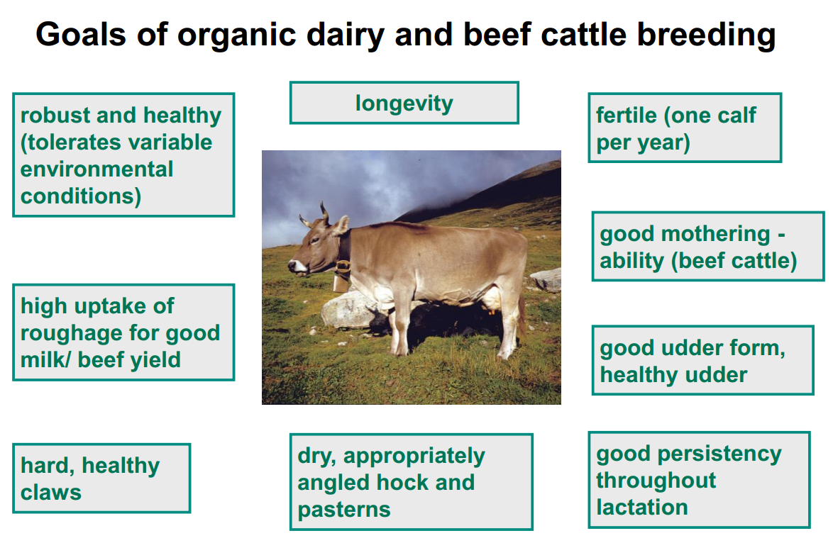

Slide 12
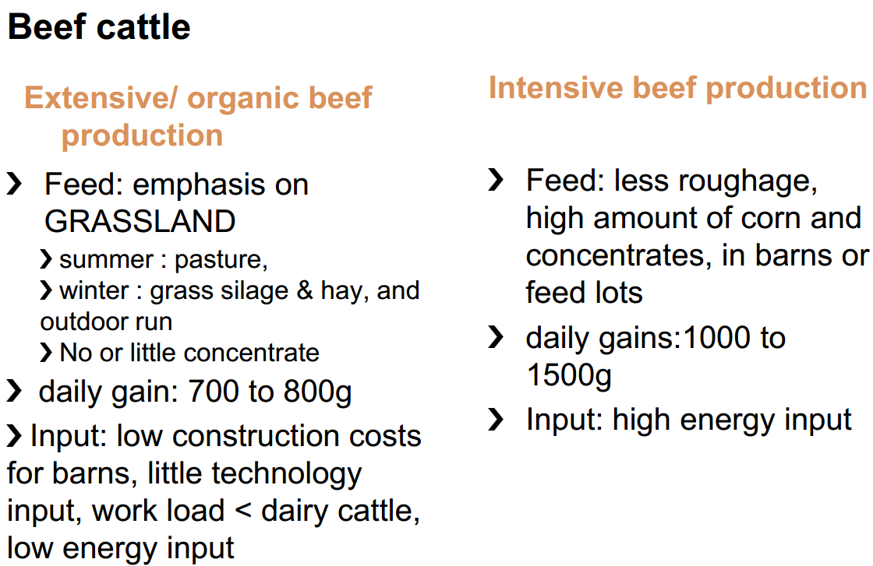

Slide 13
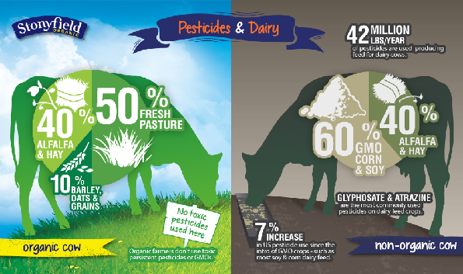

Slide 14
Organic poultry products

Slide 15
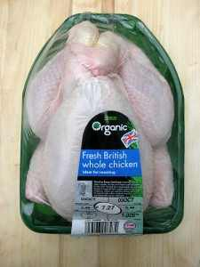
Organic poultry production system refers to:
Poultry food products produced under the free-range breeding systems in the pasture away from cages and fed organic diets without any chemical supplements.

Slide 16
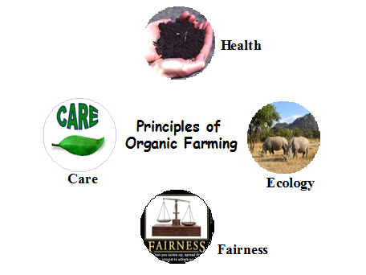
Organic Poultry Nutrition
It means breeding and feeding of poultry without the use of any chemical additives, supplements, hormone or antibiotics to the ration, and in some countries, without using genetically modified crops.
Producers of Organic Poultry Products Should be:
Not to harm or damage the environment, and all other forms of life, and
Working on the optimal management of natural resources, and
Using renewable resources and preserving the bio- diversity, and
Maintaining the Feed safety and preserving the environment for the future generations .

Slide 17
Organic Poultry System Cares for:
Bird’s health
Bird’s welfare
Quality of final product for human use
Preserving the surrounding environment

Slide 18
while
Conventional Production Systems
only interested in
Reducing the production cost
Maximizing the production capacity (weights and feed conversion)

Slide 19
The organic feed production must be based on the following six rules:
Fertile agricultural land .
2. Using minimum amount of non-renewable resources (chemicals).
3. Minimize the pollution of the surrounding environment .
4. Working with nature not against it.
5. Respect animal welfare .
6. No artificial feed additives, unless indicated

Slide 20
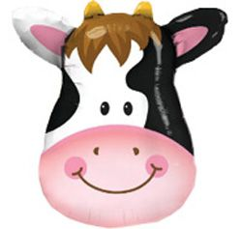
Thank you for your attention
Any questions?

